Slide 1
Intro - Max
Metadata - BD
CSS - Shervan
Parents - BD
Lunch - Max
Conclusion - Max

Slide 2
Capstone Project
Maxim Dokukin, Bhavdeep Randhawa, Shervan Shahparnia
Notes:
Intro - Max
Metadata - BD
CSS - Shervan
Parents - BD
Lunch - Max
Conclusion - Max

Slide 3
Introduction
Dataset: Students Performance in Exams

Slide 4
Objectives
Find correlation between test scores and other parameters
Identify whether or not there is a correlation between parent education and student average test scores
Identify whether there is a correlation between math, reading, and writing scores
Comparing average combined score for 3 categories against lunch availability and test preparedness to determine whether or not there is some relationship

Slide 5
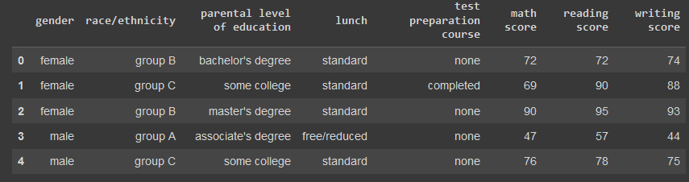
MetaData (Overview)

Slide 6
MetaData (Calculated)
Male: 482 Female: 518
Math - Max: 100 Min: 0 Average: 66.089
Reading - Max: 100 Min: 17 Average: 69.169
Writing - Max: 100 Min: 10 Average: 68.054
Number of Columns in Data Set: 8
Number of Rows in Data Set: 1001

Slide 7
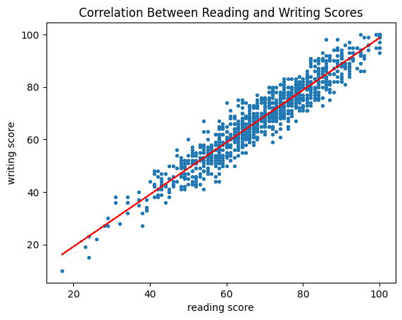
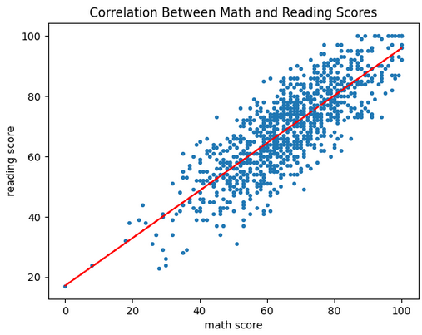
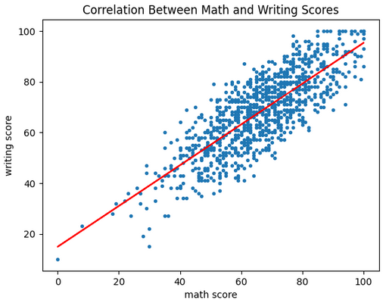
Cross subject scores

Slide 8
Data Observations and Interpretation
The average reading, writing, and math scores from all of the graphs indicate that the initial metadata obtained through awk scripts were correct
All graphs show that there is not necessarily a correlation between each individual category, but rather than students who score well in one category tend to score well in the rest
Interpretation -> better students will get good marks in all categories

Slide 9
Tools (Commands)
$sed 's/"//g' StudentsPerformance.csv.xls > StudentsPerformance.csv
$awk -F',' '{print $3 "," $6 "," $7 "," $8}' StudentsPerformance.csv > parent_education_correlation.csv
$wc -l < StudentPerformance.csv >> counts.txt
$head -n 1 StudentPerformance.csv | awk -F',' '{print NF}' >> counts.txt
$awk -F',' '{print " $6 "," $7 "}' StudentPerformance.csv >> math_reading_scores.csv
$awk -F',' '{print " $6 "," $8 "}' StudentPerformance.csv >> math_writing_scores.csv
$awk -F',' '{print " $7 "," $8 "}' StudentPerformance.csv >> reading_writing_scores.csv

Slide 10
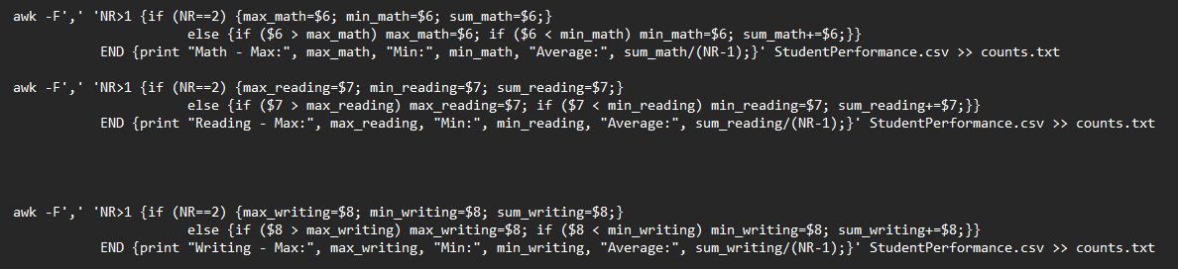
Tools (More Commands)

Slide 11
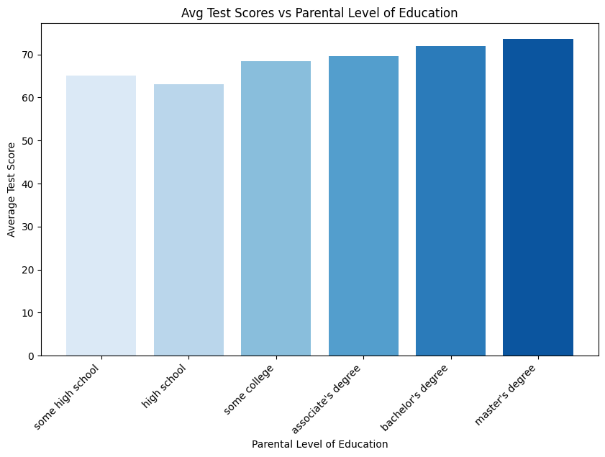
Does parents education level matters?

Slide 12
Data Observations
On average, students whose parents have completed higher levels of education are more likely to score higher
Lowest: Highschool - 63.0969
Highest: Master’s Degree - 73.5989
Each additional level of education will add approximately 2 points to score average

Slide 13
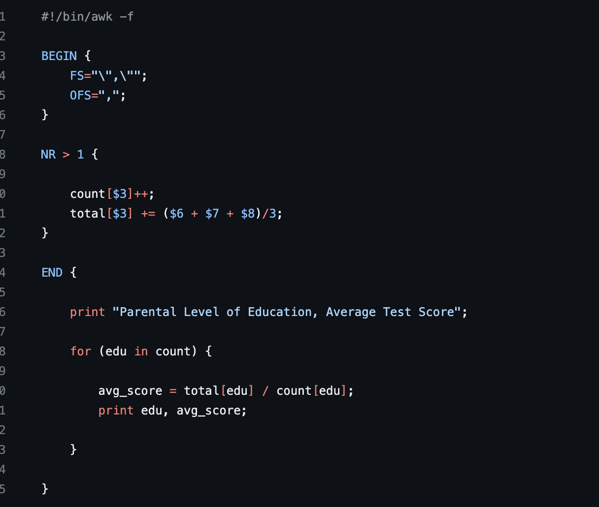
Tools (Commands)
touch parental_education_scores.awk
chmod +x parental_education_scores.awk
awk -f parental_education_scores.awk StudentsPerformance.csv >> parental_education_scores.csv

Slide 14
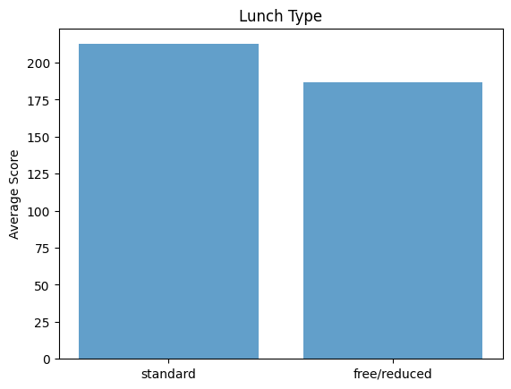
Does the lunch you get makes a difference?

Slide 15
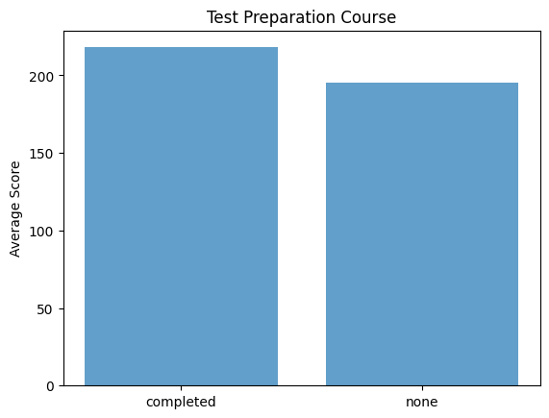
Does test prep. course worth it?

Slide 16
Data Observations
Students with full lunch perform better than once getting free/reduced.
Students who take exam preparation course perform better.

Slide 17
Tools (Commands)
$awk -F, '{sum = $6 + $7 + $8; print $0","sum}' StudentsPerformance.csv > StudentsPerformanceWTotal.csv
$awk -F, '{print $4, $9}' StudentsPerformanceWTotal.csv > lunch_totalScore.csv
$awk -F, '{print $5, $9}' StudentsPerformanceWTotal.csv > testPrep_totalScore.csv
$awk -F, '{ sum[$1] += $2; count[$1]++} END { for (category in sum) { printf "%s: %.2f\n", category, sum[category] / count[category] }}' lunch_totalScore.csv > lunchMeans.txt
$awk -F, '{ sum[$1] += $2; count[$1]++} END { for (category in sum) { printf "%s: %.2f\n", category, sum[category] / count[category] }}' testPrep_totalScore.csv > testPrepMeans.txt

Slide 18
Thank you!
Questions?

